Slide 2
http://localhost:3000

Slide 3

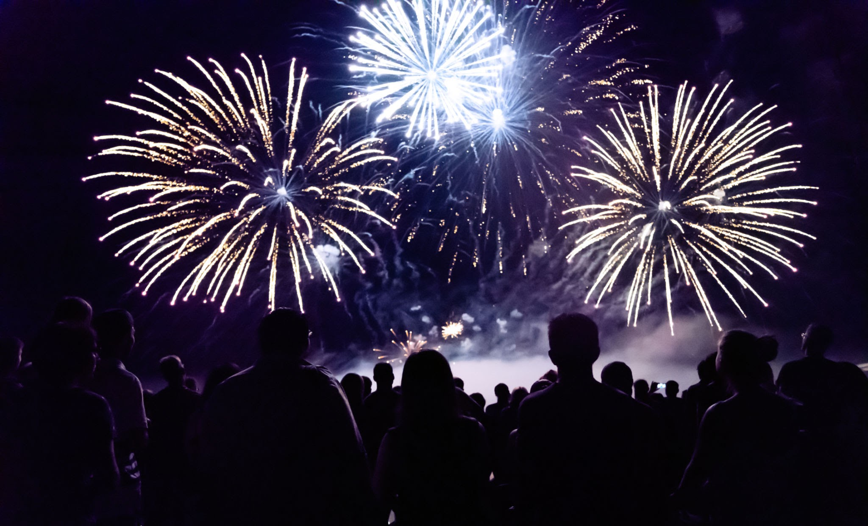
THANK YOU
I wish to commence this extended expression of gratitude by offering you, the listener, my most profound and deeply felt appreciation for the expenditure of your temporal resources and the lending of your auditory attention. It is with a sense of overwhelming humility and sincerest thankfulness that I stand here, metaphorically or perhaps literally, at the conclusion of this discourse to articulate the two simple yet infinitely complex words: thank you.
Thank you for listening. I feel compelled to repeat this sentiment, to iterate it through the varying lenses of human emotion and intellectual recognition, because the act of listening in an age of distraction is no small feat. You have offered me your silence, you have offered me your focus, and you have allowed the vibrations of my voice, or the text upon this screen, to enter your consciousness and reside there, however briefly. For that, I am eternally grateful. It is a gift that you have given me, a gift of presence, a gift of mind, and a gift of spirit. I do not take this lightly. I do not take this for granted. I acknowledge the weight of your attention, and I thank you for placing it upon the scales of our interaction.
As I bring this presentation, speech, or written composition to a close, I must ask—nay, I must implore—do you have any questions? The floor is now yours. The microphone, should there be one, is passed from my hand to yours. The spotlight shifts from the speaker to the audience. Do you have any questions? Perhaps you seek clarification on a point that was obscured by the fog of my verbosity? Perhaps you wish to challenge a premise that I have laid before you like a foundation stone? Or perhaps you simply wish to express your own thoughts, adding to the tapestry of this dialogue with a thread of your own weaving?
Please, do not hesitate. The silence that follows a question can be a daunting thing, a void that begs to be filled. But let that void be filled with your inquiries. Do you have any questions about the content? Do you have any questions about the context? Do you have questions about the methodology, the philosophy, the raison d'être of this entire endeavor? If you do, now is the appointed time. Now is the moment of inquiry, the moment where the monologue transforms, through the alchemy of curiosity, into a dialogue.
I want to thank you again, because repetition is the sincerest form of emphasis, and I wish to emphasize my gratitude. Thank you for enduring the moments that may have dragged, thank you for engaging with the moments that sparked, and thank you for simply being there, a receptive vessel for the output of my mind. It is a rare and beautiful thing to be heard. In a world that is constantly shouting, constantly broadcasting, constantly demanding to be seen and heard, the act of listening is a quiet rebellion. It is an act of kindness. It is an act of connection. So, I say once more, with every fiber of my being: thank you for listening.
But we must return to the pivotal inquiry, the catalyst for the next phase of our interaction: Do you have any questions? I urge you to search the depths of your mind. Rummage through the archives of your thoughts. Is there a "why" that lingers? Is there a "how" that remains unanswered? Is there a "what" that still needs defining? If there are questions, let them fly. Let them soar on the wings of curiosity. Let them land upon the table for dissection and discussion. I am here, I am ready, and I am willing to answer. I am prepared to go deeper, to explain further, to backtrack if necessary, or to forge ahead into new territories of thought based on your prompting. Do you have any questions? This question hangs in the air, waiting for a response like a pendulum waiting to swing.
And as we hover in this space between the conclusion of my speaking and the potential beginning of your questioning, I want to extend my thanks for your patience. Thank you for your patience with my cadence, thank you for your patience with my articulation, and thank you for your patience with the duration of this closing statement. It is my desire to leave no stone of gratitude unturned. I want to ensure that you feel appreciated, that you feel valued, and that you feel thanked. Thank you. Thank you. Thank you.
So, as we draw the curtain on this performance, as the credits roll on this cinematic experience of words, I leave you with the final, lingering echo of my request. The floor is open. The door is ajar. The invitation is extended. Do you have any questions? Do you have thoughts you wish to share? Do you have insights you wish to impart? The stage is set for the next act, but it requires your voice to begin. And until that voice is heard, I will remain here, in a state of anticipatory gratitude, thanking you once more for the privilege of your listening ear.

